Slide 1

Food Ordering Management System
CSC 430 Project Proposal By: Ryan Callicott and Ethan Ubeda

Slide 2
Application Area:
Standard restaurant paradigms have shifted post-COVID. Traditional sit-down restaurants have needed to adopt to carry-out and delivery options. Old infrastructure isn’t sufficient.
Users will view a menu via a web application, and they will select menu item(s), payment method, and delivery method, designated as an Order.
Orders will be sent to employees to be prepared. A subset of relevant orders will be sent out for delivery.
Orders will be used to create receipts, which will be given to the customer with their order.

Slide 3
Needs for Web Application
Web Application must display all menu items and prices.
Users must be able to submit orders for at least one menu item. Users must choose between delivery or carryout and take information accordingly.

Slide 4
Database Requirements
Order keeps track of each product and their prices
Employees keep track of the orders progress and status

Slide 5
Entities
Customer[Customer_ID, Name, Email, Password, Phone#, Address]
Employee[Employee_ID, Name, Phone#, Email, Password]
Product[Product_ID, Name, Description, Price]
Vehicle[Vehicle_ID, Status, Registration#]
Order[Order_ID, Product_ID, Customer_ID, Order_date, Vehicle#, Delivery, Quantity]

Slide 6
Relationship
Places(Customer, Order)
Delivery(Employee, Order)
Contains(Order, Product)
Uses(Employee, Vehicle)

Slide 7
Constraints
Each order has access to the full menu and is presented to the user
Has different payment methods and options for pickup or take out or delivery
1 Employee can only deliver 1 order at a time
Every customer must have a name
An employee can have 1 order a day
The delivery option can be void if the distance is over 20 miles
Order can have as many duplicate product as it wants

Slide 8
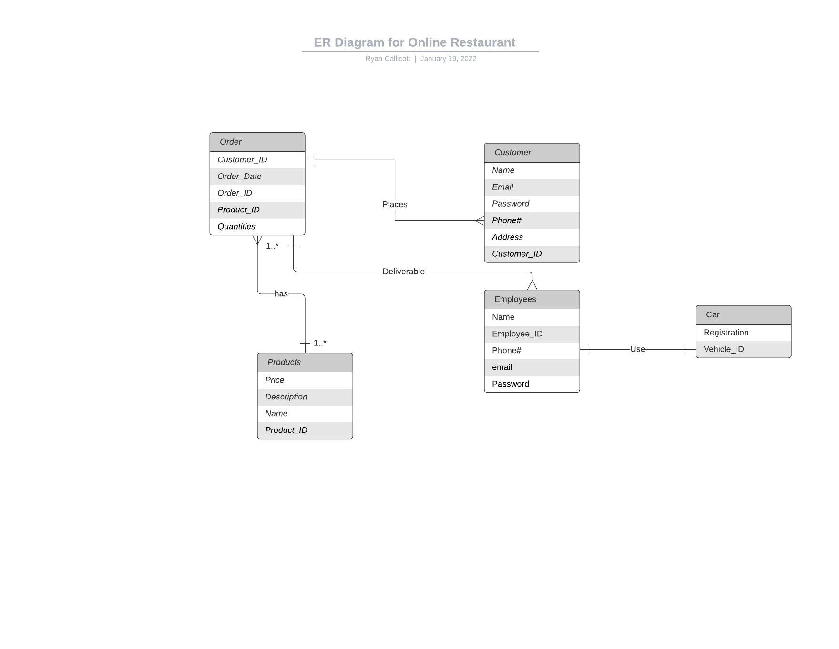

Slide 9
Timeline
Start creating tables using DDL commands in SQL in Week 1
Start Research, Import, and Create Data on Week 2
Create queries using DML commands start on Week 3
Create the User-Interface starting from Week 4

